Slide 1


Supervision of pensions
2025 - 2029
Wednesday, 17 September 2025
The Round Room at The Mansion House

Slide 2
Supervision of pensions 2025 - 2029
Welcome and introduction
David Begg
Chairman
The Pensions Authority

Slide 3
Supervision of pensions 2025 - 2029
Keynote Address
Dara Calleary TD
Minister for Social Protection and Rural and Community Development and the Gaeltacht

Slide 4
Supervision of pensions 2025 - 2029
The European Outlook
Matti Leppälä
Secretary General / CEO of PensionsEurope

Slide 5
The European Outlook
The Pensions Authority Conference 2025
Dublin, 17 September 2025
Matti Leppälä

Slide 6
PensionsEurope: A Voice for Funded Pensions in Europe
Represents national pension fund associations across Europe
  Both occupational and personal pensions.
€6+ trillion in assets — over 100 million Europeans covered
Engaging with EU policymakers to build strong, sustainable pension systems
”Good pensions for the people in Europe”

Slide 7
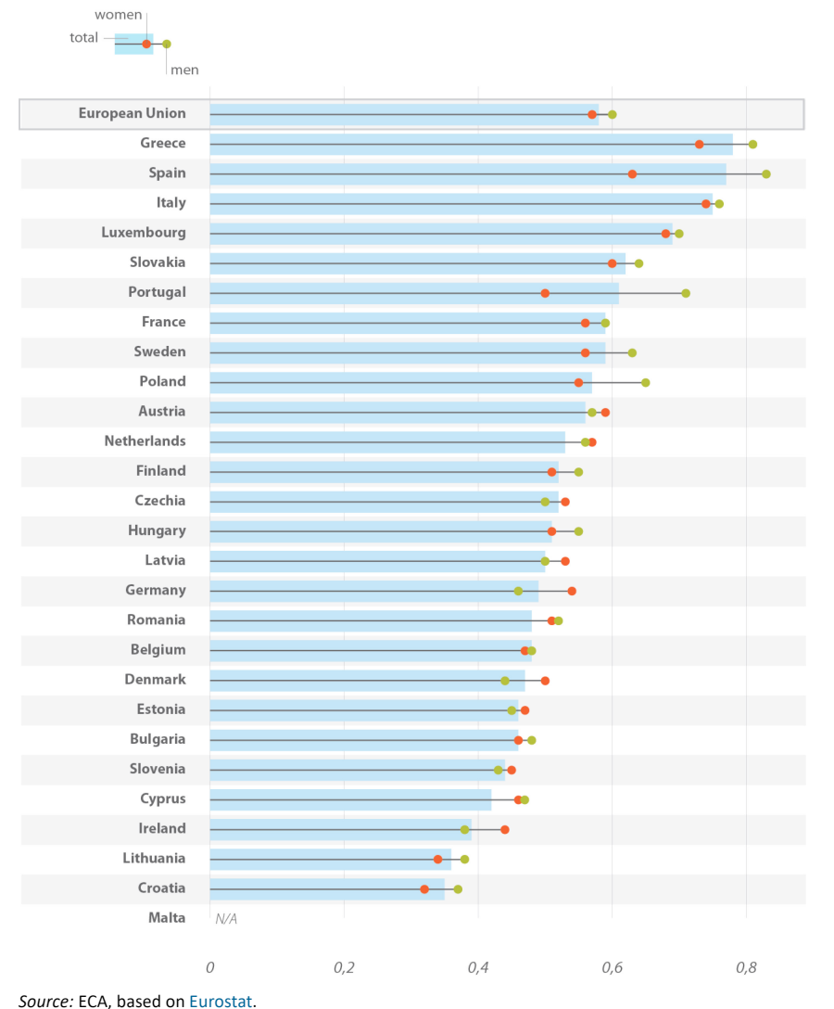
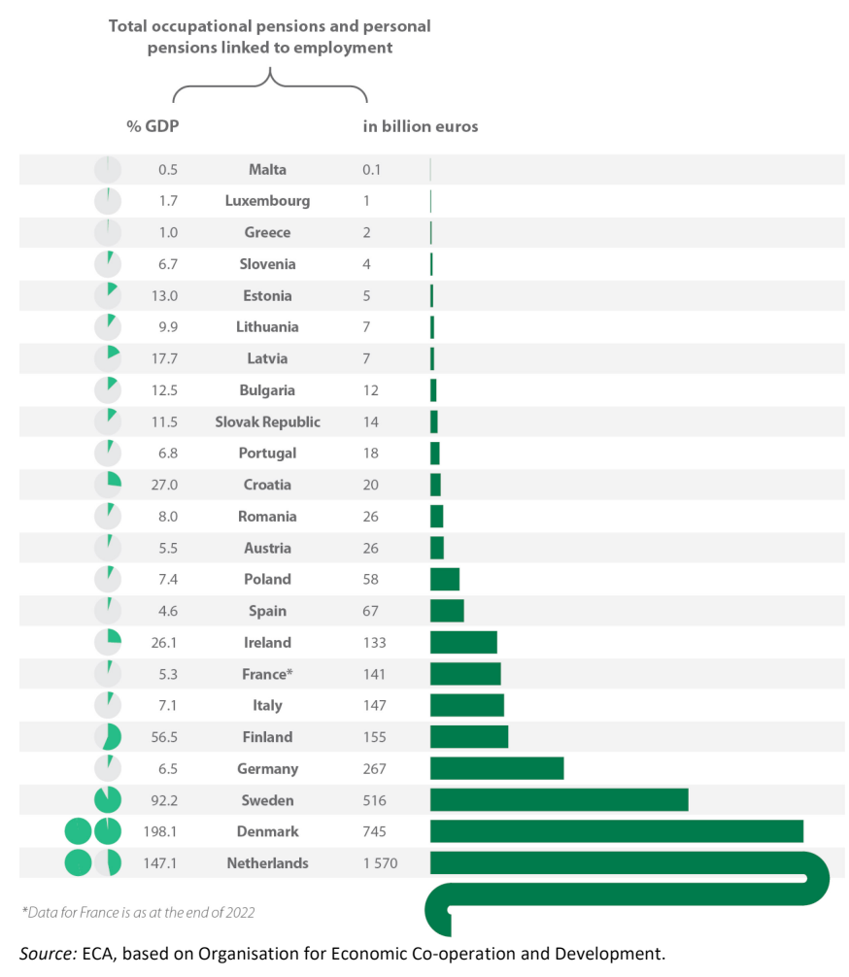
Replacement levels and role of funded pensions diverse in Europe

Slide 8
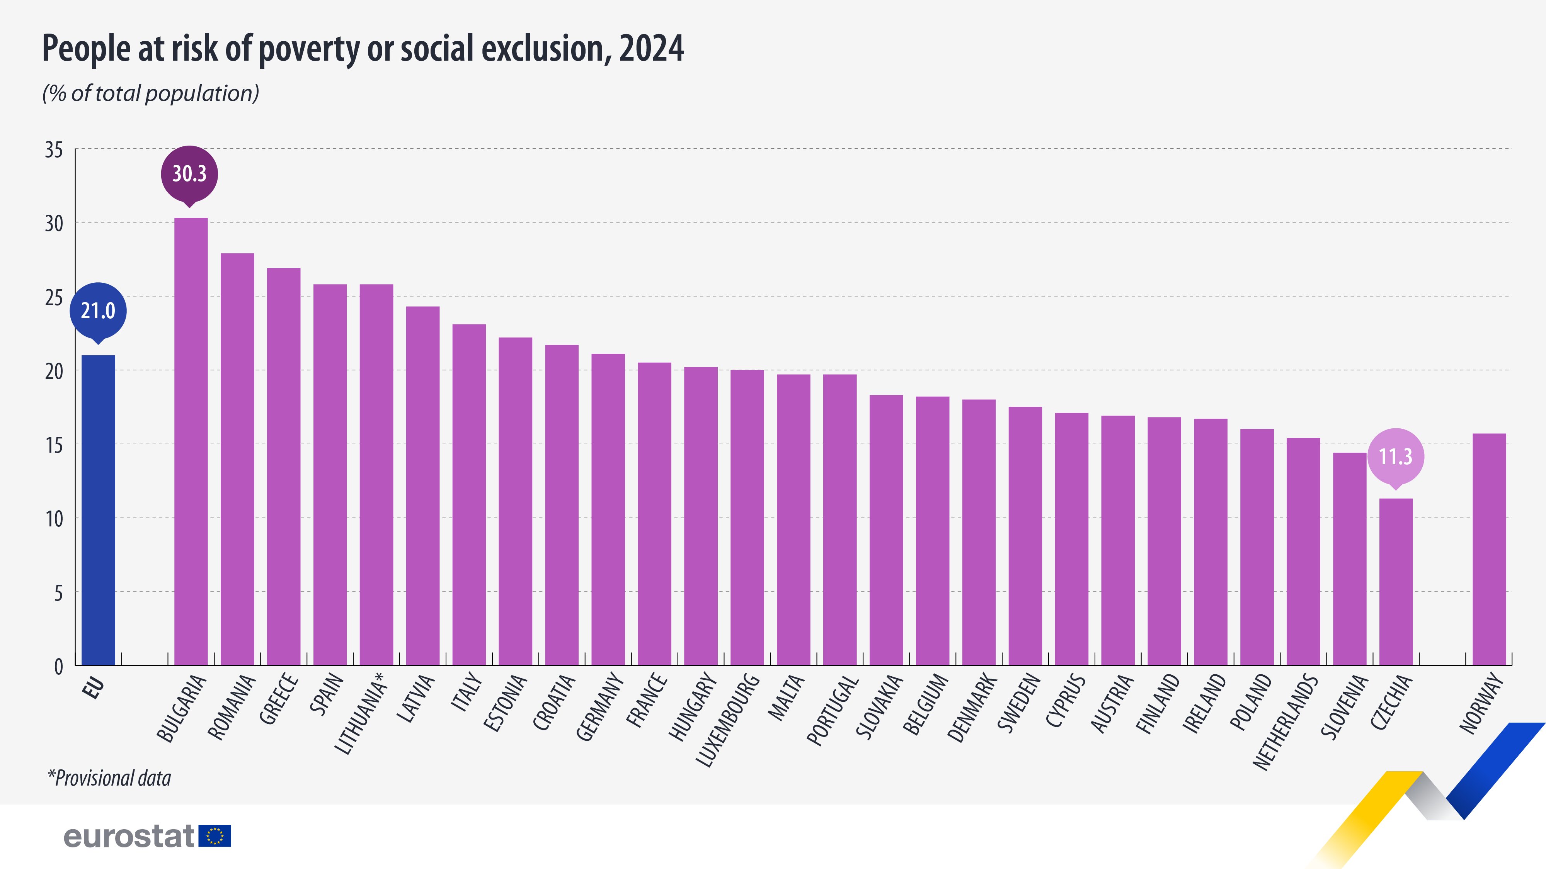

Slide 9
Current Trends and Challenges
Ongoing shift to Defined Contribution (DC) due to cost and risks.
Closure and merging of DB plans in some countries.
Funding and sustainability challenges in mature systems.
  Negative cashflows in mature DB systems (e.g., UK, Finland).
Need for improved funding ratios and sustainable plan management.
Importance of hybrid solutions and regulatory support.

Slide 10
EC Consultation on supplementary pensions -PensionsEurope’s views
Pension Tracking Systems (PTS)
  Should remain a Member State responsibility; must integrate statutory + supplementary data
  Key challenges: impartiality, data reliability, costs
Pension Dashboards
  Should show long-term trends and enable societal debate
Auto-enrolment
  Effective to increase coverage, but needs sufficient contributions
  Flexibility for Member States; involve social partners
PEPP Regulation review
  Must fit national contexts; lifecycle strategy can help
  Workplace PEPPs risk complicating 2nd pillar
IORP II Directive review
  Prudent person principle works; no new quantitative limits needed
  Cross-border issues mainly due to tax & labour-law differences
  Scope should stay same; principle-based communication preferred

Slide 11
EIOPA & OPSG VIEWS
EIOPA’s technical proposals:
IORP II:
  Address prudential implementation challenges
  Make prudent person rule more risk-based to boost alternative-asset investment
  Clarify scope/definitions; strengthen supervision framework
PEPP (“EuroPension”):
  Simpler brand & features, flexible cost cap, fewer sub-accounts
  Improve cross-border scale, reduce costs, improve returns
General tools:
  Use IORPs or workplace PEPPs as auto-enrolment default
  Link national PTS to European ETS and improve decumulation info
OPSG’s key messages:
PTS: include all pillars, use clear language, secure access, avoid double reporting
Dashboards: use existing data, no EU-wide rankings
Auto-enrolment: protect paritarian models; MS decide
PEPP: reform fee cap, advice rules, cross-border portability; no transfers from occupational schemes
IORP II: keep principles-based & flexible, no scope expansion; small IORPs can perform well

Slide 12
The Future is All About Data
ESAP and digitalisation reshaping data flows
FIDA: trilogues ongoing — defend IORP specificities
DORA: in force, burdensome for small IORPs → drives consolidation
AI Act: limited risk use cases only (chatbots, asset mgmt); low impact
Digital Omnibus (Dec 2025): may simplify GDPR & AI Act

Slide 13
Smarter Reporting, Not Just More Reporting
EIOPA new rules (2025): higher thresholds, new data on derivatives
ECB data since 2019 — review expected 2026
Support alignment of EIOPA, ECB, Eurostat, OECD, NCAs
“One single reporting” & proportionality — cut costs

Slide 14
A Level Playing Field, on Our Terms
Pensions seen as part of wider financial markets — expectations rising
Stronger governance, transparency and digitalisation
Rules must reflect long-term, non-profit nature of IORPs
Aim: best possible outcomes for members, not box-ticking compliance
Focus on outcomes for members, not formal compliance

Slide 15
SFDR, CSRD, CSDDD and Omnibus
SFDR: proposals due early 2026 — fix Art. 8/9 misuse, data gaps
  Diverging views: exclusion vs better fit for IORPs
  Exclude gov bonds, treasury assets from transition pathways
Omnibus: EP vote Oct–Nov 2025
CSRD: oppose higher thresholds / weaker assurance
CSDDD: keep EU civil liability regime (avoid fragmentation)

Slide 16
Looking Ahead: Opportunities and Challenges
SFDR review and CSRD/ESRS will reshape sustainability disclosures
Digitalisation promises efficiency, but needs investment, skills and legal clarity
Consolidation must bring scale without losing trust or diversity
We need an EU framework that enables — not overburdens — pensions

Slide 17
Conclusion: Building the Future Together
Data, digitalisation and sustainability will define the next decade
Regulation must empower pension funds — not overwhelm them
Together, we can deliver secure pensions and fuel Europe’s growth

Slide 18
Supervision of pensions 2025 - 2029
The changing landscape of Irish pensions
Andrew Nugent
Director of Supervision, Enforcement, Policy and Legal
The Pensions Authority

Slide 19

The changing landscape of Irish pensions
Andrew Nugent, Director of Supervision, Enforcement, Policy and Legal
Pensions Authority Conference 2025

Slide 20
Pensions landscape
Figures as at Q2 2025
The pensio landscape
Group DC schemes
9k
Active members
(DC,DB, public sector)
1.3 million
Scheme and PRSA assets
€162 billion
Master Trusts
17
DB schemes
(subject to Funding standard)
441
RAs
86
PRSA contracts
311k
OMAs
90k

Slide 21
Master trusts
Master trusts
  12 Group scheme master trusts; and
  5 Retail master trusts for one member arrangements (OMAs)
June 2023
  Members 315k
  Assets under management (AUM) €13.9bn
  Participating employers 15k
June 2025
  Members 659k
  Assets under management (AUM) €35.2bn
  Participating employers 30k

Slide 22
Master Trusts
Members (active and deferred): 659k at end of June 2025
Assets under management: €35.2bn

Slide 23
Group schemes
Derogated OMAs have consolidated, remaining numbers per PDR are methodological differences i.e. life cos consider them to be derogated.
Scheme type | Jan 2023 | Sept 2025 | Reduction
Group DC schemes | 17,500 | 9,135 | 48%

Slide 24
OMAs
Derogated OMAs have consolidated, remaining numbers per PDR are methodological differences i.e. life cos consider them to be derogated.
Scheme type | Jan 2023 | Sept 2025 | Reduction
OMAs | 141,500 | 90,921 | 36%

Slide 25
PRSAs
PRSAs Q1 2023
  Assets €9bn
  Contracts 237k
PRSAs Q2 2025
  Assets €20bn
  Contracts 311k

Slide 26
Growth in PRSAs continues to be in non-standard
PRSA assets

Slide 27
The
DB schemes

Slide 28
The
PA view of the post-consolidation landscape
Master trusts
<500 single employer DC group schemes – further waves of consolidation?
OMA provision through retail master trusts and PRSAs
DB schemes in run off still with significant assets
RACs in run-off
Buy out bonds – will play a part with derogated OMAs
My Future Fund

Slide 29
The
Forward look – issues on the horizon
Scheme authorisation
EU legislation/requirements e.g. DORA, ESAP, IORP review, PEPP review
Additional data requirements
PA supervision focus

Slide 30
Supervision of pensions
2025 - 2029
Tea / coffee break
Wednesday, 17 September 2025
The Round Room at The Mansion House

Slide 31
Supervision of pensions 2025 - 2029
Pensions Authority consultations – current and planned
Gillian Smith
Policy Unit
The Pensions Authority

Slide 32
Pensions Authority consultations: current and planned
Gillian Smith, Policy Unit

Slide 33
Overview
Legal basis
Legislative process
Approaches
Recent
Planned

Slide 34
Legal basis for PA consultations
Section 10(1) of the Pensions Act provides the functions of the PA include:
to monitor and supervise the operation of this Act and pension developments generally
to advise the Minister either at his request or on its own initiative on all matters relating to the functions assigned to the Authority under this Act and on matters relating to pensions generally

Slide 35
Legislative process
The Oireachtas is the only body with the power to make laws.
Process for new legislation is onerous.
Secondary legislation is also subject to high standards.
Non-legislative interventions sometimes viable alternative – guidance, codes, voluntary mechanisms.

Slide 36
Approaches to consultation
Proposal
  - DC master trust code, PRSA code of conduct
Call for evidence
  - DB consolidation
Targeted
  - trustee survey, direct engagement with stakeholder(s)

Slide 37
Recent consultation – DB consolidation
Background
Post IORP II consolidation in DC
Master trust model
Nature and complexity of DB v DC
Call for evidence
Could a DB master trust market function well in Ireland?
How could it best be regulated?

Slide 38
Call for evidence
Consultation paper comprised 27 questions, across four subjects.
Model (DB master trust)
Potential impact
Operation
Regulation

Slide 39
Preliminary analysis
Public consultation
11 submissions.
Mixed views.
Potential benefits: reduced employer costs on governance and investment management.
Potential risks: lack of demand → lack of scale and efficiencies, lack of competition.

Slide 40
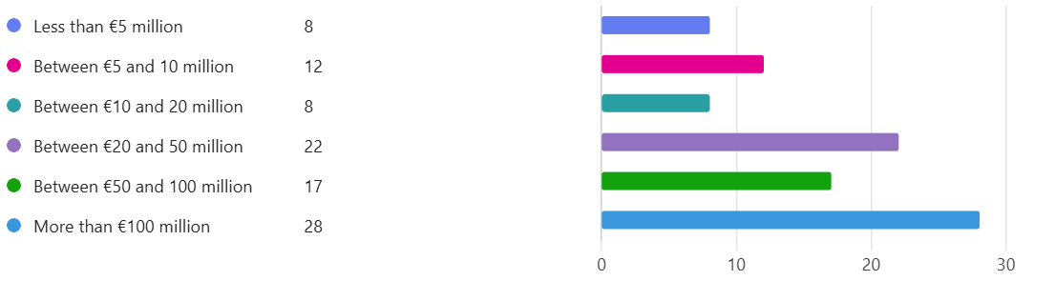
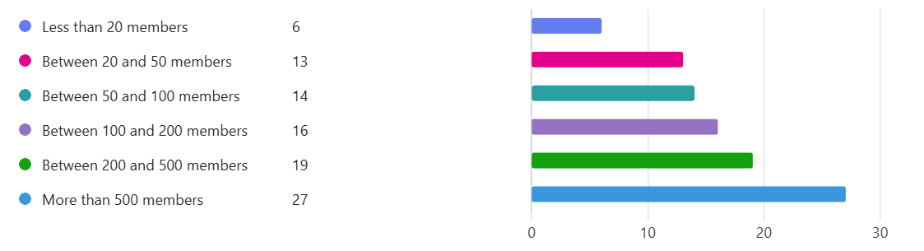
Targeted consultation
Survey of DB trustees - 95 responses.

Slide 41
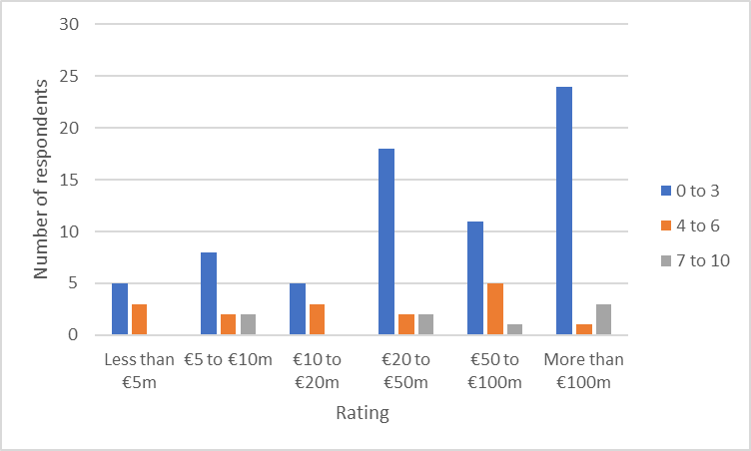
Trustee survey
How likely is it that your scheme would join a MT if available?
10 = extremely likely, 0 = not very likely

Slide 42
DB consolidation
Analysis of submissions remains in progress.
Long-term plans and other options available for DB schemes also under consideration.
Clear and strong rationale required to justify any legislative amendments.

Slide 43
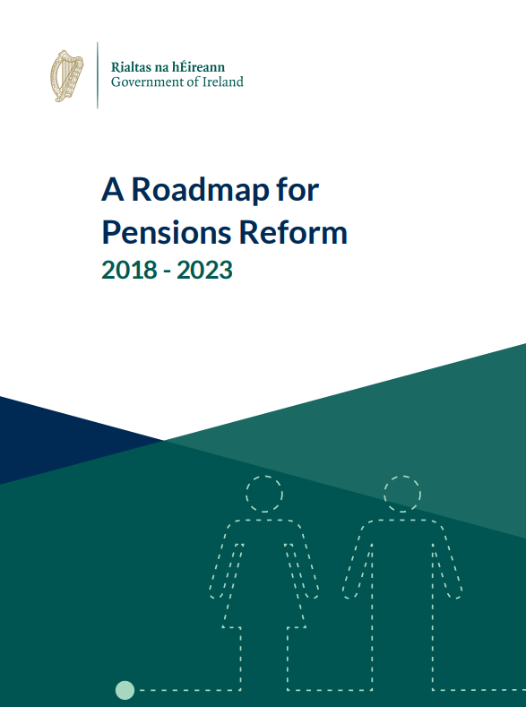
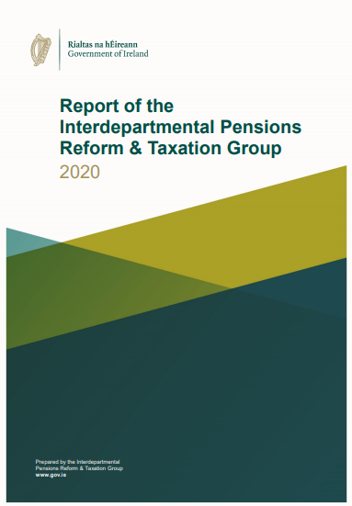
Upcoming consultations – In-scheme drawdown
Background
Government mandate for
IDPRTG to review ARF and
potential introduction of
in-scheme drawdown.
IDPRTG concluded legislative amendments for in-scheme drawdown should be progressed.

Slide 44
Upcoming consultations – In-scheme drawdown
Call for evidence approach
  Model for ISD and regulatory framework.
  Provision of ISD, trustee duties, default investment strategy, disclosure of information, member costs, drawdown-only schemes.

Slide 45
Upcoming consultations - PRSA investment rules
Policy context
  Level of savings in PRSAs: €20bn, 66% in non-standard
  Increased use of non-standard: reversal of S/NS pattern
  Investment rules
Public consultation by end of 2025.

Slide 46
Thank you
Stakeholder input is critical and valued part of PA decision making process.
We look forward to hearing your views in upcoming consultations.
consultation@pensionsauthority.ie
PRSAconsultation@pensionsauthority.ie

Slide 47
Supervision of pensions 2025 - 2029
Data at the centre of supervision
John Gethin
Director of Strategy, IT, Data
and Operations
The Pensions Authority
Fionnuala Ryan
Supervision and Enforcement Unit
The Pensions Authority

Slide 48
Supervision of pensions 2025 - 2029
(round table discussion)
Matti Leppälä
Secretary General/CEO of PensionsEurope
Alan Boland
Head of Function - Domestic Life Insurance Supervision, The Central Bank of Ireland
John Gethin
Director of Strategy, IT, Data and Operations, The Pensions Authority
Fionnuala Ryan
Supervision and Enforcement Unit, The Pensions Authority

Slide 49
Supervision of pensions 2025 - 2029
Closing remarks
Brendan Kennedy
Pensions Regulator
The Pensions Authority

Slide 50
Supervision of pensions
2025 - 2029
Wednesday, 17 September 2025
The Round Room at The Mansion House

